Slide 1
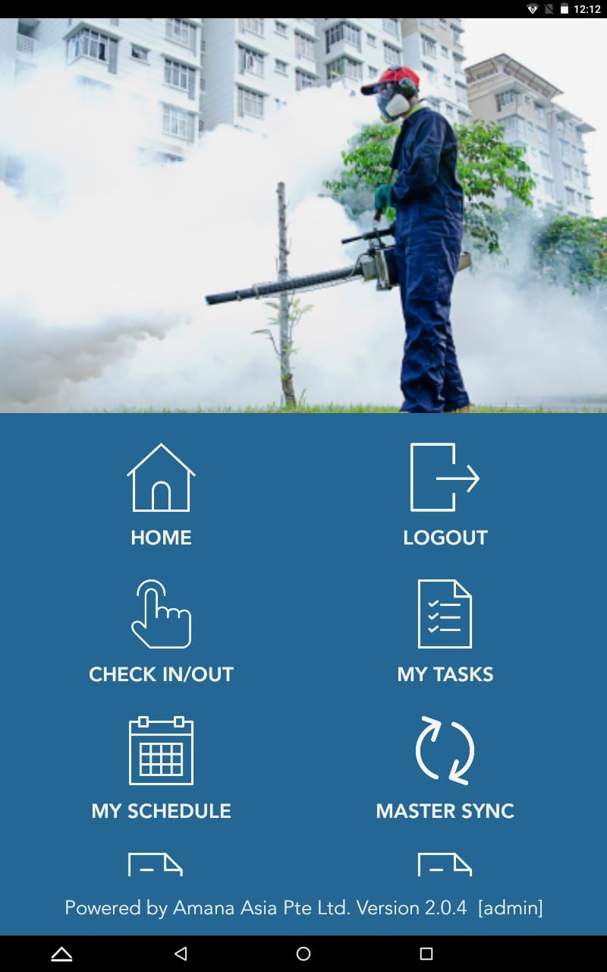

Log Out
Add in Message to office ->
Remove
Move Up
Add in Chemical Order -> Form ( technician can pre order chemicals and upload it for office to prepare for them)
Remove
Add in Equipment List->
Remove

Slide 2
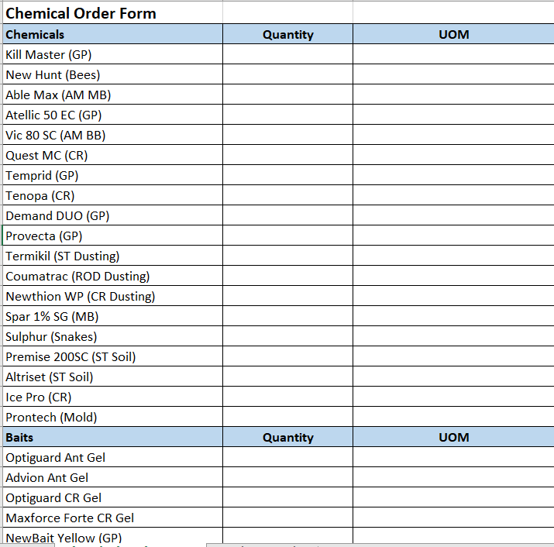
Chemical Order Form
Change it to a drop down box broken into different categories and they can select quantity. Office will also be able to change and add in new chemicals.
Technicians will not be able to see the amount of stock left. Only which is out of stock.
Pls refer to attachment Chemical List -> Chemical Order Form

Slide 3
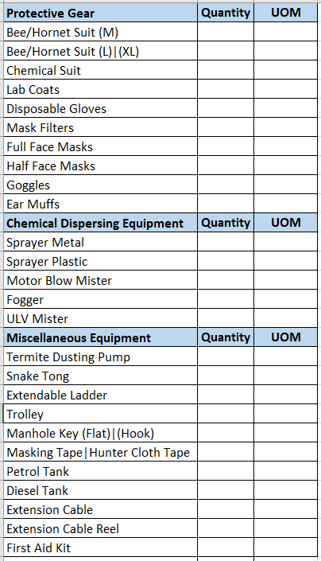
Equipment List Form
Change it to a drop down box broken into different categories, this is to indicate items in their van.
Pls refer to attachment Chemical List -> Equipment Form

Slide 4
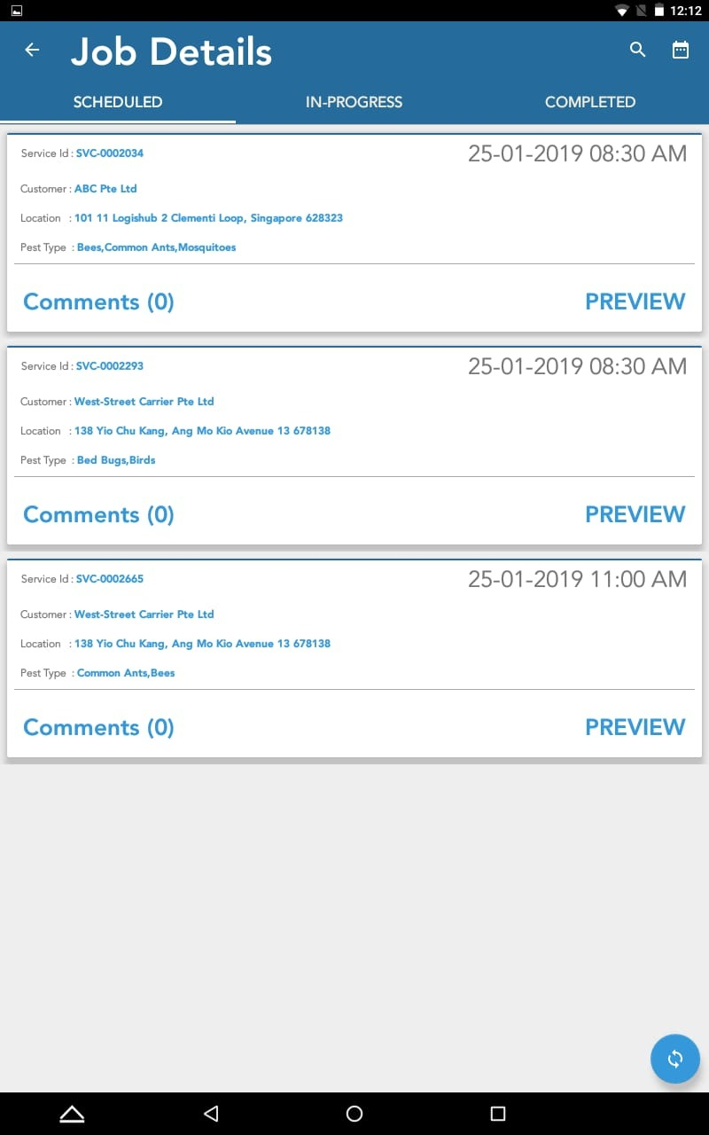
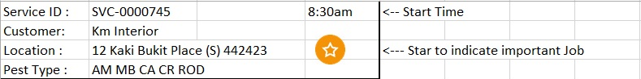
Comments (0)
Location
Jobs with the exclamation mark, service reports will be sent back to office for vetting before being sent to customer. Without star the service reports will auto send to client once its uploaded
Comments (0)
Location
Comments and location change it to a button, if there are comments button will be Red. comments can be written by previous tech who did the job or office staff, only office staff can edit and delete comments
Comments (2)
Location
When this area is clicked it will preview the job
Make Font bigger
Notes:
History of job

Slide 5
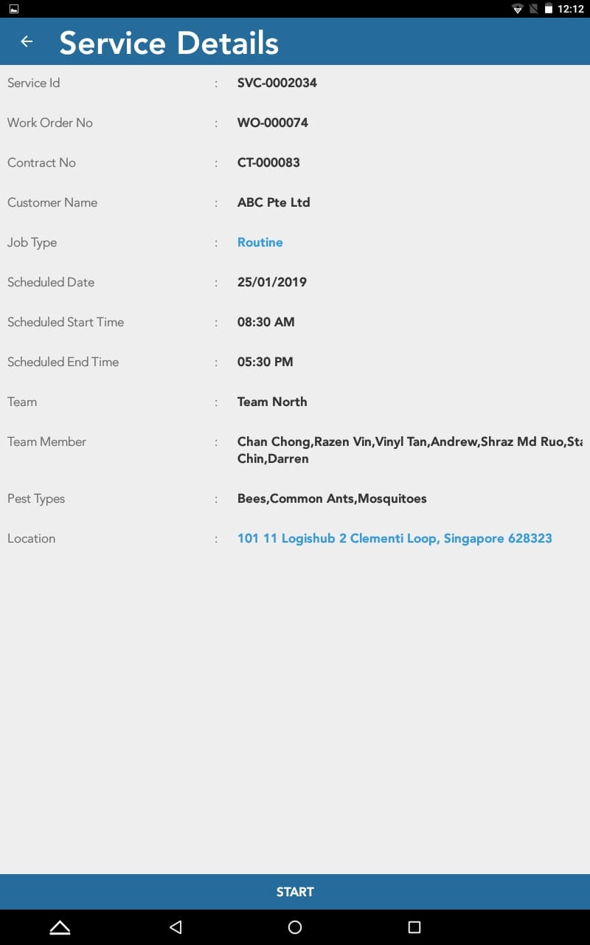
Service ID | : SVC-0000251
Work Order No | : WO-000074
Customer Name | : ABC Pte Ltd
Person in Charge | : Mr Tan Ah Beng
Contact No. | : 88776655
Job Type | : Initial Service
Team Member | : Ghani
Location
Pest Coverage | AM - Misting
 | MB - Larvaciding
 | CA - Gel baiting, Residual Spraying
 | CR - Bin Chute Fogging
 | ROD - Baiting, Dusting
Remarks | Cockroach infestation in at blk 12 Bin Chute
Office can select to show them the phone number, by default the number is left blank
Initial Service, re-infestation service, Ad-hoc, follow-up or routine. Above are the 5 options which will appear and only the 2 in red will be shown in red and the rest in black
12 Kaki Bukit Drive #12-13 Singapore 415652
Button can be clicked and linked to directions
Special remarks in red
Past Service Reports
7 Jan
14 Jan
21 Jan
28 Jan
They will be able to see the past service photos and remarks from the previous tech up to 4 services back
Pest Trending Needed
Will only appear if pest trending is needed
Start
Bigger Start Button
Notes:
Maps and floor plans

Slide 6
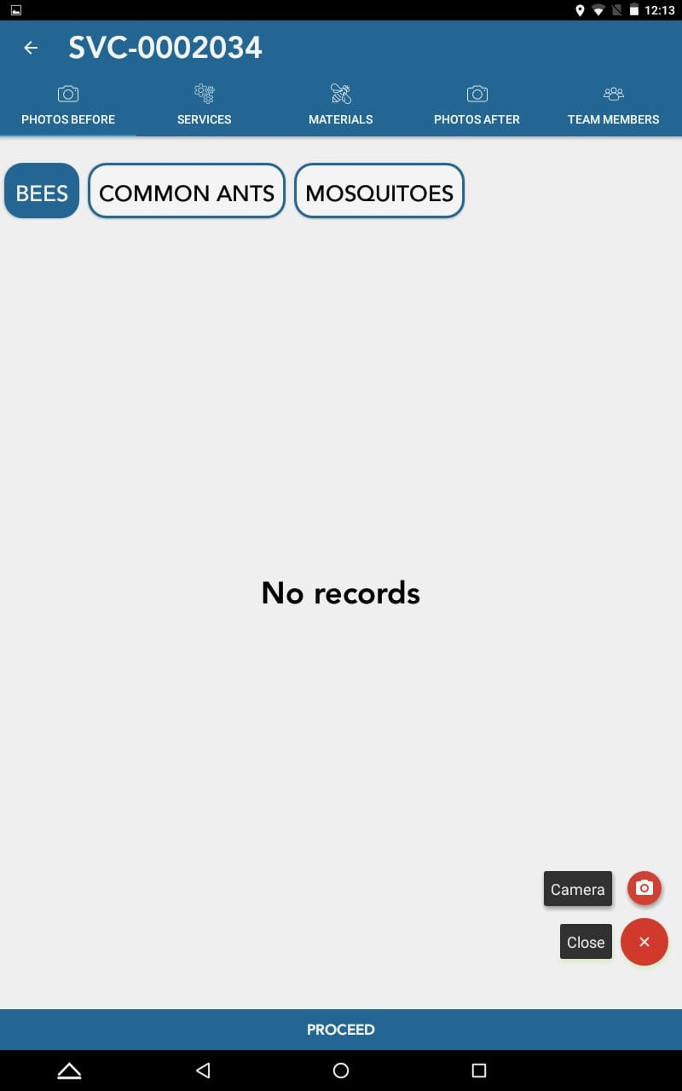
Services
Feedback
Infestation Level
Payment
End Service
Your icons there are still good, just different names
Remove Proceed Button for all page

Slide 7
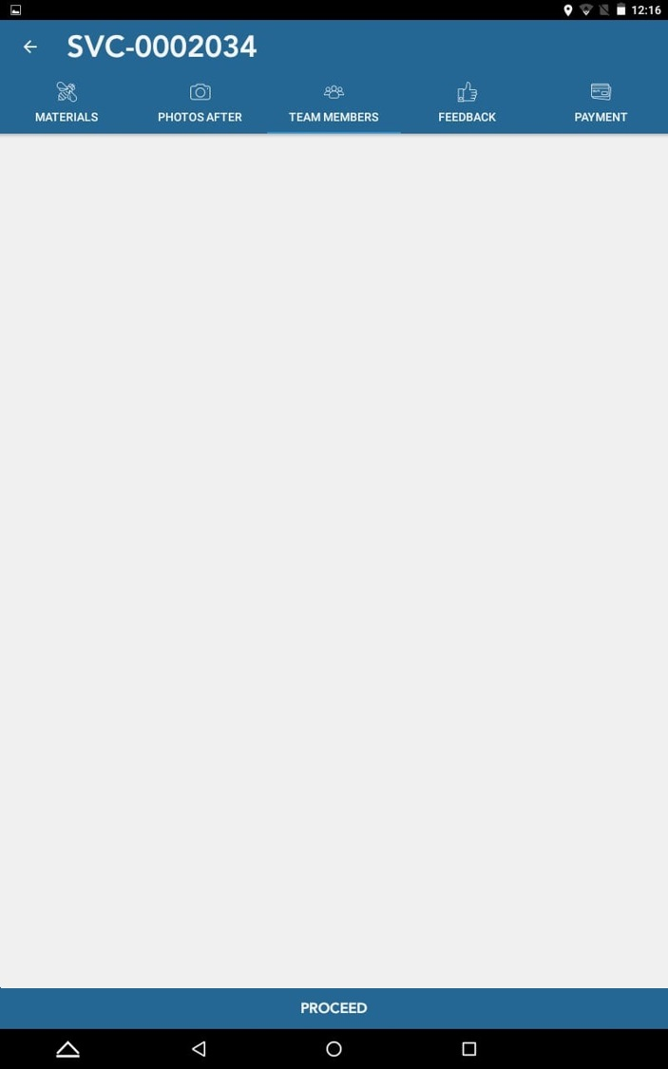
Services
Services
Feedback
Infestation Level
Payment
End Service
Mosquito Breeding Treatment: Larviciding
Chemical: Able Max Dilution: 20ml / 5 litre water
SOP
Adult Mosquito Treatment: Misting
Chemical: Vic 80 SC Dilution: 100ml / 5 litre water
SOP
When clicked will show other dilution rates as a pop out. Will provide details later for all chemicals dilution
Cockroach Treatment: Bin Chute Fogging
Chemical: Able Max Dilution: 20ml / 5 litre water
SOP
Rodents Treatment: Baiting
Chemical: Rodenticide
Dilution: Half Piece Per Hole
SOP
Termites Treatment: Dusting
Chemical: Termikil
Dilution: Nil
SOP

Slide 8

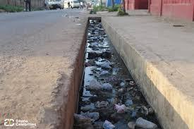
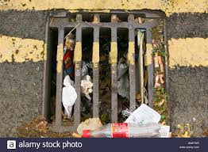
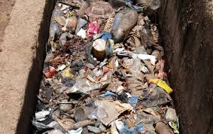



Photos
Services
Feedback
Infestation Level
Payment
End Service
Camera mode to take photos or can be selected to upload photos, multiple photos are possible
Blk 1, Mosquito Breeding in drains
Small photo icons will be shown, if they want to delete the photos it will pop out a box to confirm delete
Comments
More Boxes can be added for comments and photos
Anything to be deleted a prompt will appear
Save
Notes:
Chat box , save button

Slide 9
Services
Feedback
Infestation Level
Payment
End Service
Pest Type Infestation Level
Mosquito Breeding
Adult Mosquito
Cockroach
Rodents
Common Ants
Termites
Low
Infestation level Nil, Low, Medium, High
Low
Low
Low
Low
Low
Clear
Save

Slide 10
Services
Feedback
Infestation Level
Payment
End Service
Service ID: SVC-00002034
Amount Payable: $1,500.00
Or (No Payment collection required) will be shown in this field
Bank Transfer
Cash
Cheque
Once Clicked it will turn yellow
Amount Received
Name of Bank
Cheque No.
Remarks
Notes:
Service ID, payment using bank transfer

Slide 11
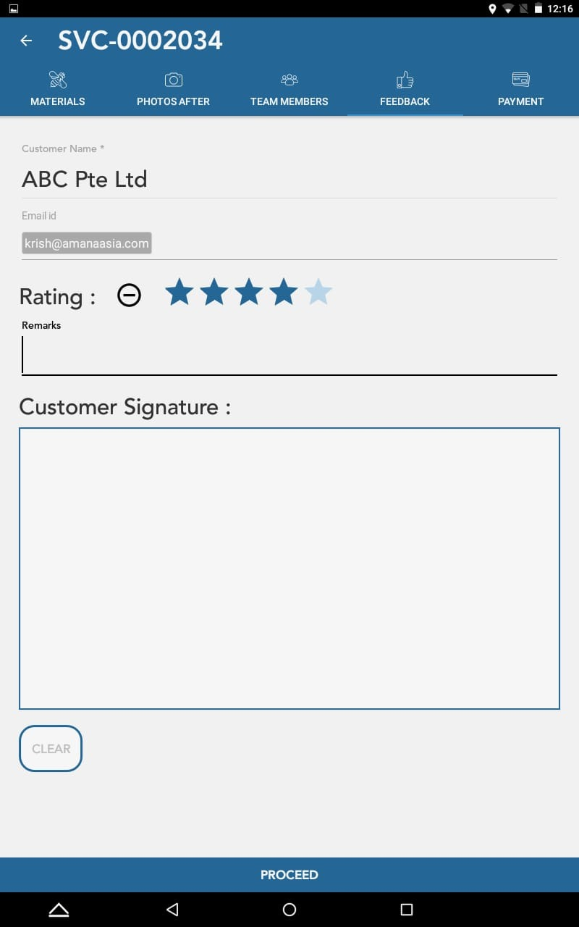
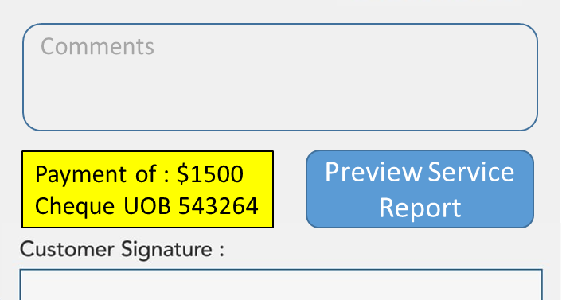
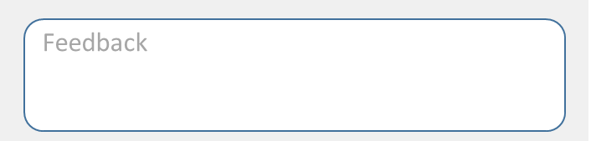
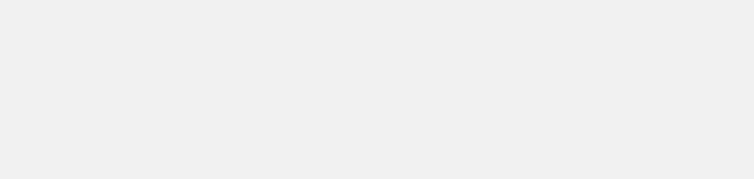
End Service
Services
Feedback
Infestation Level
Payment
End Service
Services
Feedback
Infestation Level
Payment
End Service
When service is stop location and time will be captured again
If no payment is made it will indicate that no payment is made, if its using bank transfer. It will put as pending bank transfer.
Please Rate Our Service
Attitude:
Appearance of Technician:
Service Quality:
Punctuality:
Feedback
Button will pop outwards to be able to click when there is a signature
Payment of : $1500 Cheque UOB 543264
Preview Service Report
When clicked there will be a pop out to confirm if customer is not present
Clear
Submit
Customer Not Present
Notes:
Amount payable, amount recieved

Slide 12
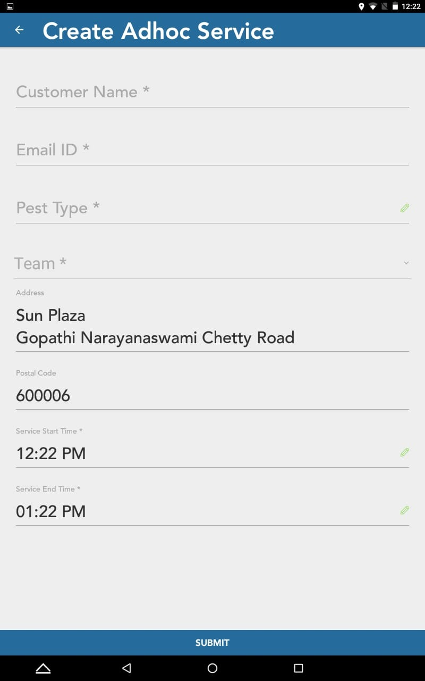
Remove

